Slide 1
"Digital Media Primer" Yue-Ling Wong,
Copyright (c)2013 by Pearson Education, Inc. All rights reserved.

Slide 2
Chapter 3
Capturing and Editing Digital Images
Part 7
Output Images for Web

Slide 3
In this lecture, you will learn:
the characteristics, pros, and cons of the common file formats for Web images
how to choose image file format for Web
what dithering means

Slide 4
Common File Formats for Web Images
JPEG
GIF
PNG

Slide 5
JPEG
best with:
  continuous-tone images with a broad color range
  subtle color and brightness variations
  e.g., photographs and images with gradients.
JPEG supports 24-bit color (millions of colors)
JPEG compression: lossy
(it loses image data in order to make the file size smaller)

Slide 6
JPEG
Does not work well with:
  solid colors
  A color solid is the three-dimensional representation of a color model, an analog of the two-dimensional color wheel. The added spatial dimension allows a color solid to depict an added dimension of color variation.
  contrast image
  contrast edges
Highly compressed JPEG images:
  blur the image detail
  show a visible artifact around the high contrast edges

Slide 7
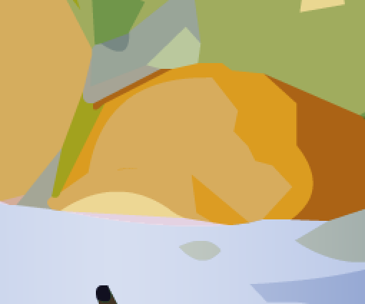
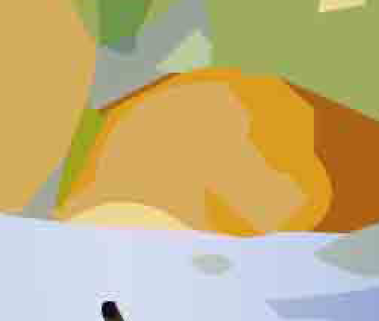
JPEG Compression Artifacts
Original
Highly compressed JPEG
Note the ugly artifacts at the intersection between 2 colors.
The solid colors are not solid colors anymore.

Slide 8
GIF
most effective for images with solid colors such as illustrations, logos, and line art
Up to 8-bit color (256 colors)
supports background transparency
animated GIF

Slide 9
Color Reduction
GIF uses a palette of up to 256 colors to represent the image
Need to reduce the colors if the original image has more than 256 colors
Advantage:
Smaller file size after reducing number of colors (i.e., reducing bit-depth or color-depth)
(Recall that reducing bit-depth or color depth can reduce file size.)

Slide 10
Color Reduction
Determine which colors are in the palette. Options available in Photoshop
Perceptual
Selective
Adaptive
Restrictive
Custom

Slide 11
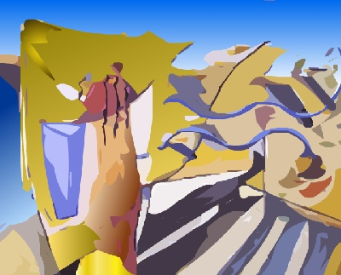
Example: Original TIF
(file size: 406 KB)

Slide 12
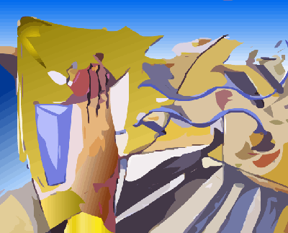
Example: GIF 256 colors, no dither
(file size: 28 KB)

Slide 13
Example: GIF 256 colors, no dithering
(file size: 28 KB)
Note the stripes in the gradient areas.
This is due to not enough colors.

Slide 14
Color Reduction
Undesirable effects
  stripes in smooth gradient areas
  some colors are altered (remapped to a different colors on the palette)
Use dithering to reduce the undesirable effects

Slide 15
Dithering
  A technique to simulate colors that are outside of the palette by using a pattern of like colored pixels.

Slide 16

Example: GIF 256 colors, with dithering
(file size: 34 KB)
The stripes in the gradient areas are less noticeable.

Slide 17
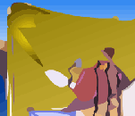

Without and With Dithering
Reduce the stripes effect
Smooth out the color transition

Slide 18
Without and With Dithering
Some colors are not solid anymore, but with dithering

Slide 19
PNG
PNG-8
  up to 256 colors (8-bit)
PNG-24
  24-bit colors
  lossless compression
  larger file size than JPEG but without the ugly JPEG compression artifacts

Slide 20

1. Hands-on to optimize files in JPEG, GIF, and PNG formats and to adjust the compression settings to achieve the balance between the file size and overall image quality.
2. Learn the type of images that each of these file formats is most effective at compressing.
Also try out the worksheet:
WORKSHEET: JPEG VERSUS GIF VERSUS PNG

Slide 21
Review Questions
Note to instructor:
Depending on your preference, you may want to go over the review questions at the end of this lecture as an instant review or at the beginning of next lecture to refresh students' memory of this lecture.

Slide 22
Review Question
What kind of images are GIF files most appropriate for?
A. big areas of solid colors
B. continuous tone photographs
C. lots of gradients
Notes:
A

Slide 23
Review Question
What kind of images are JPEG files most appropriate for?
A. big areas of solid colors
B. continuous tone photographs
C. lots of gradients
Notes:
B and C

Slide 24
Review Question
Which file format(s) can be created as an animated sequence?
A. JPEG
B. PNG
C. GIF
Notes:
C

Slide 25
Review Question
Which file format(s) can have transparency?
A. JPEG
B. PNG
C. GIF
Notes:
B and C

Slide 26
Review Question
Saving an image with more than 256 colors into a GIF may have the undesirable effects as discussed in the lecture.
So why or when would you want to save an image as a GIF?
Notes:
reduce file size
create an animated gif
background transparency (although PNG can have transparency)

Slide 27
Review Question
In general, a PNG-24 file has a larger file size than a JPEG.
So why or when would you want to save an image as a PNG instead of a JPEG?
Notes:
lossless compression (so you can keep it for further editing)
no ugly JPEG artifacts
an image that has contrast edges and solid colors (which JPEG does not work well with)

